Slide 1

Fitness App – Your Personal Fitness Companion
Track. Train. Transform. Your ultimate fitness partner.

Slide 2




Team and Contribution
Aryan Gupta- UI and Database
23BRS1142
Pranav Kumar Thakur- User Sign Up and Authentication
23BRS1136
Akshit Kumar Rajput - UI , Firestore and Backend
23BRS1147

Slide 3

The Problem We’re Solving
Fitness Tracking
Hard to maintain daily fitness.
Missed Tracking
Users often forget to track meals/workouts.
No Central App
Missing combined calorie, workout, step tracking.

Slide 4
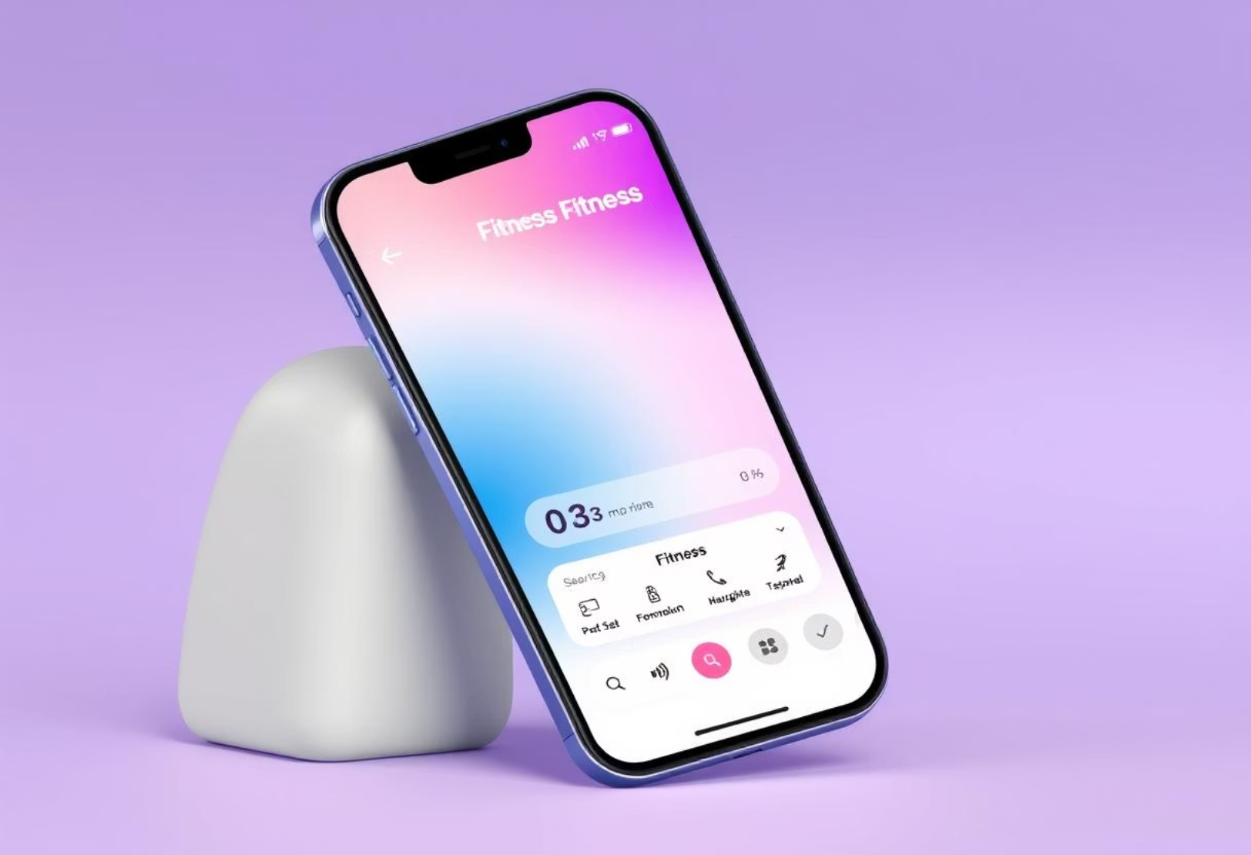
Our Solution: Fitness App
A health & fitness Android app:
Tracks calorie intake from meals.
Tracks calories burned via workouts/steps.
Offers personalized routines/macros.
Securely stores user data.
User-friendly UI with Jetpack Compose.

Slide 5
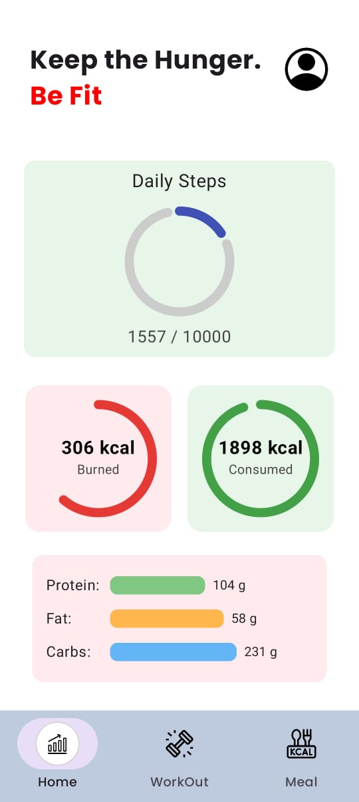







Core Features of FitMate
Calorie Calculator
Routine Guidance
Meals and drinks.
Workout info.
Exercise Tracker
Google Sign-In
Repetitions counted.
Secure authentication.
Macro Breakdown
Firestore Integration
Nutrient analysis.
Firebase sync.
Live Step Count
Via pedometer.

Slide 6






App Architecture
UI Layer
Jetpack Compose Screens.
Data Layer
ViewModel, DataStore.
Firebase Layer
Firestore, Auth, Storage.
Navigation Layer
Components, Context.
Permissions
Activity Recognition, Sensors.

Slide 7
Tech Stack Used
Development Environment
Android Studio
Programming Language
Kotlin + Jetpack Compose
Backend/Database
Firebase Firestore & Auth
Local Storage
DataStore
Architecture
ViewModel & MVVM
Collaboration
GitHub

Slide 8
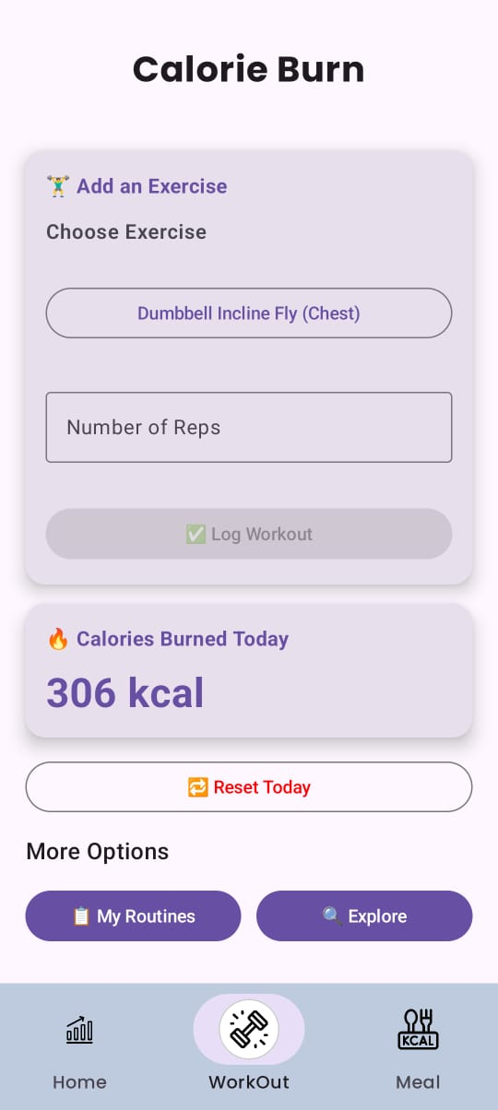
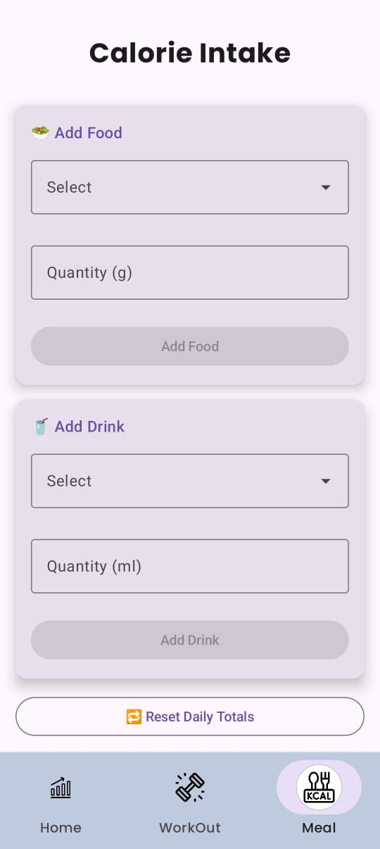
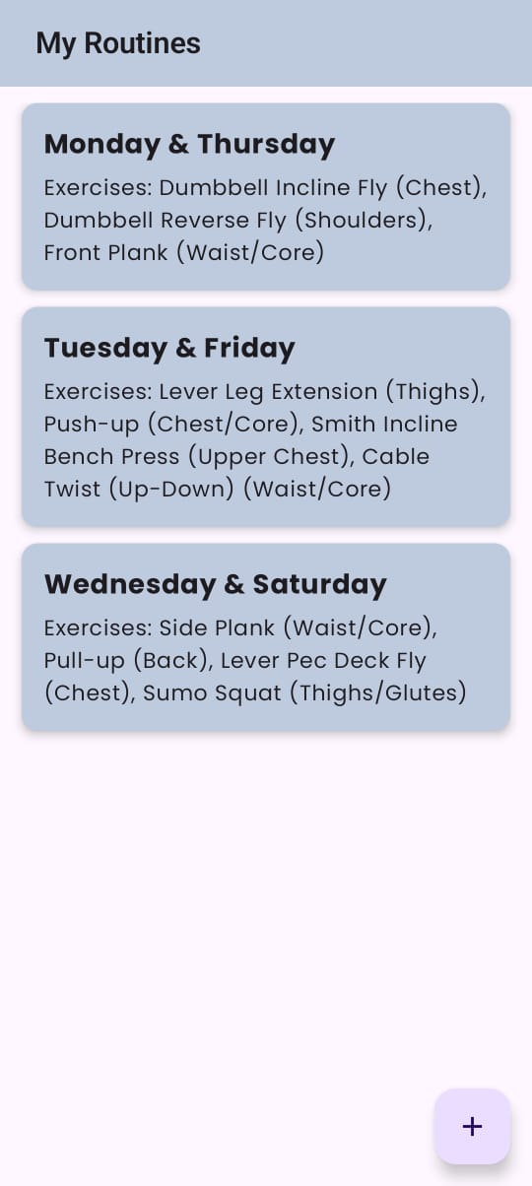
User Interface Highlights
Visual tour of Fitness App's intuitive design.

Slide 9
User Data Handling
Secure Access
Real-time Sync
Local Persistence
Google Sign-In.
Firebase Firestore.
DataStore.
Private Collections
Session Management
User-specific data.
AuthViewModel handles state.

Slide 10
What We Learned
UI Updates
Complex UI States
Using ViewModels.
Real-time with Jetpack Compose.
Permission Management
Effective Collaboration
Via Git & GitHub.
Handling ACTIVITY_RECOGNITION.
Data Syncing
Firestore and DataStore.

